Slide 1
How to build
a phylogenetic tree using Vietnamese SARS-COV-2 data?

Slide 2
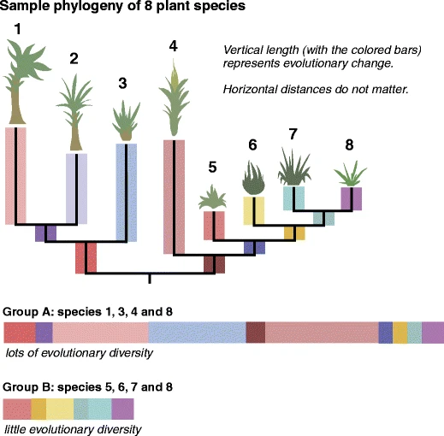
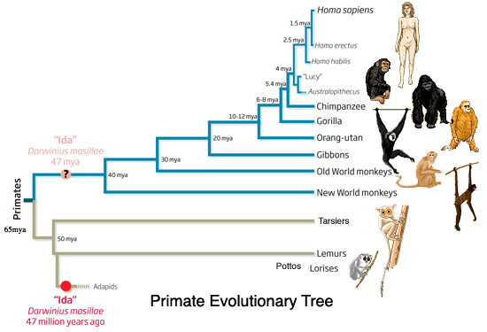
What is a phylogenetic tree?
A phylogenetic tree is an estimate of the relationships among taxa (or sequences) and their hypothetical common ancestors
Nei M, Kumar S. , Molecular evolution and phylogenetics,
2000 New YorkOxford University Press
Thanukos, A. Evolutionary Trees from the Tabloids and Beyond.
Evo Edu Outreach 3, 563–572 (2010).

Slide 3
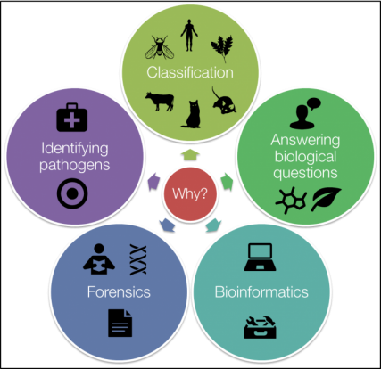
Why is a phylogenetic tree necessary?
Understanding evolutionary history and relationships
Guiding classification and taxonomy
Contributing to conservation and biodiversity efforts
Assisting in biomedical research and disease control
Providing powerful tools for diagnosis and legal investigations
Notes:
Ví

Slide 4
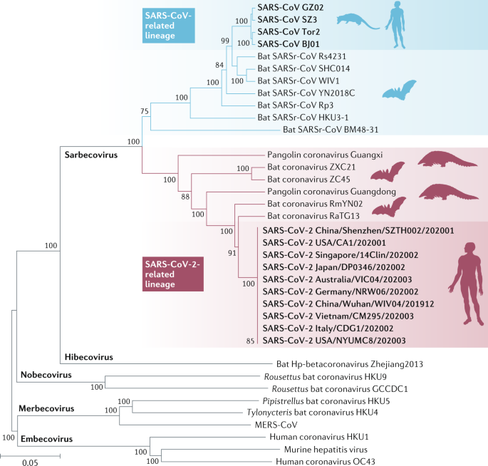
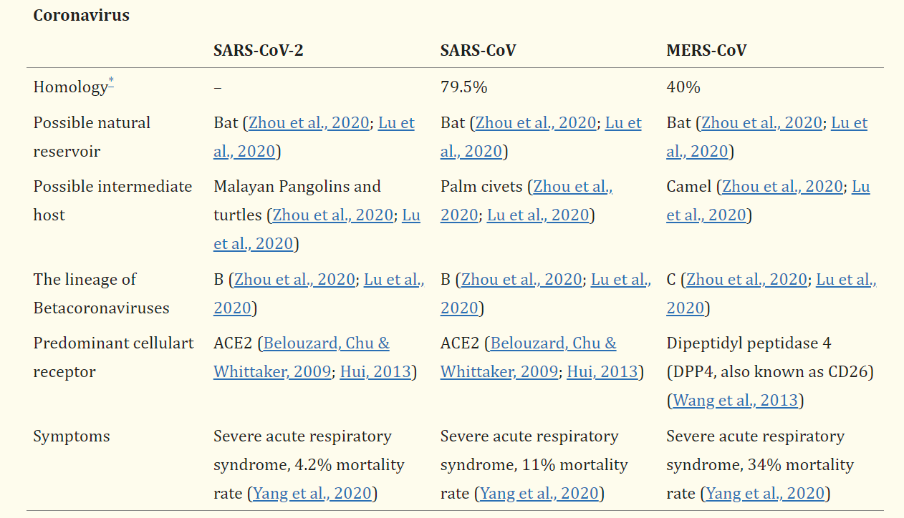
Why is a phylogenetic tree necessary?

Slide 5
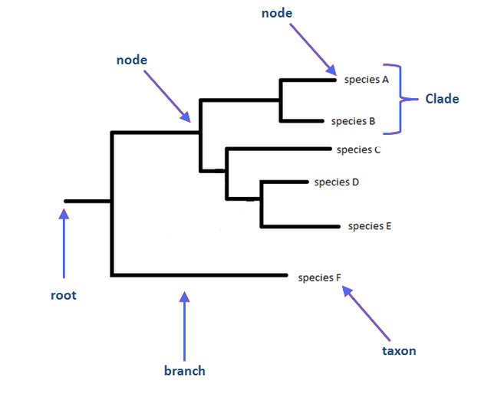
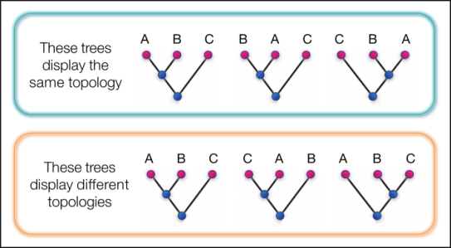
How to read a phylogenetic tree?
Some major aspects of phylogenies and how we can be interpreted. Specifically we focus on:
Topology
Branches
Nodes: Tips, Internal nodes, Root
Confidence
Part of a phylogenetic tree. (Li and Goldman, 1998).

Slide 6
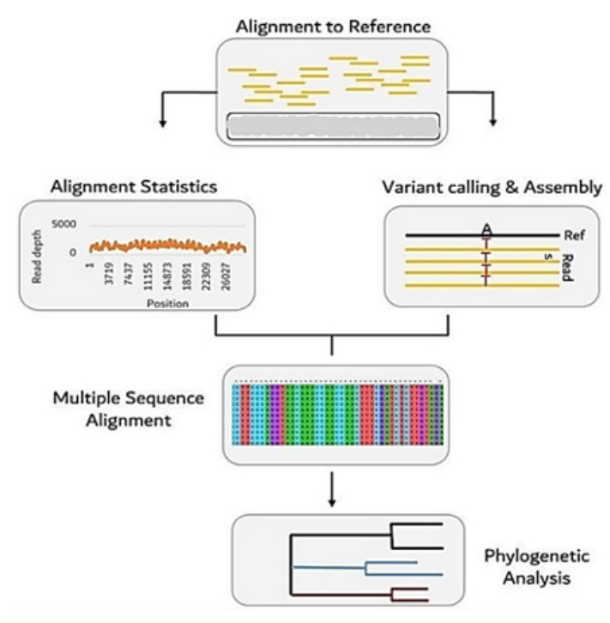
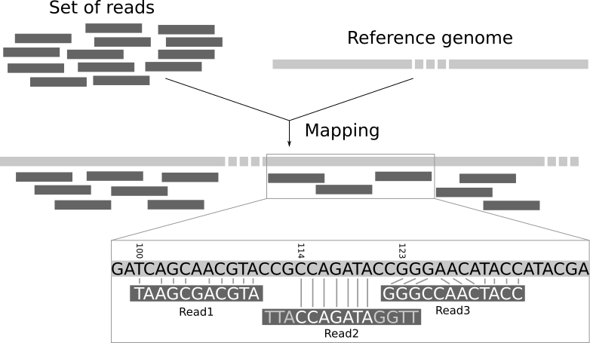
How to build a phylogenetic tree?
Building a phylogenetic tree requires four distinct steps:
(Step 1) identify and acquire a set of homologous DNA or protein sequences
(Step 2) align those sequences
(Step 3) estimate a tree from the aligned sequences
(Step 4) present that tree in such a way as to clearly convey the relevant information to others.
Barry G. Hall, Building Phylogenetic Trees from Molecular Data with MEGA,
Molecular Biology and Evolution, Volume 30, Issue 5, May 2013, Pages 1229–1235.
Notes:
Đưa các option build tree

Slide 7
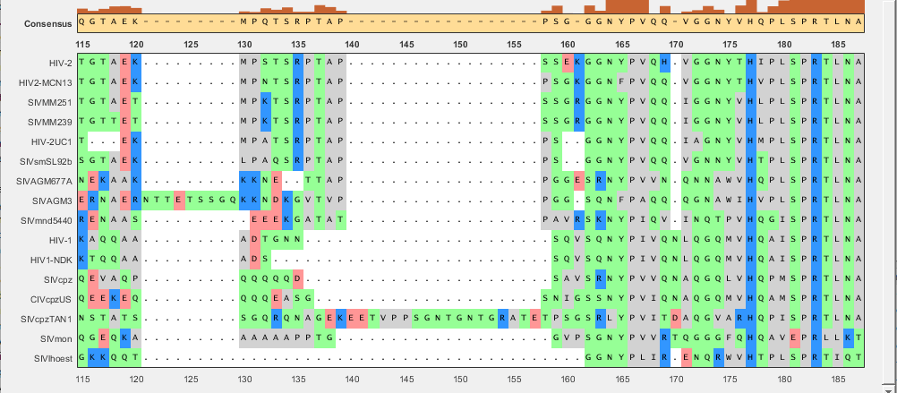

Why is aligment necessary?
Sequence alignment is the process of comparing and detecting similarities between biological sequences.
Pairwise alignment
Multiple Sequence Alignment

Slide 8
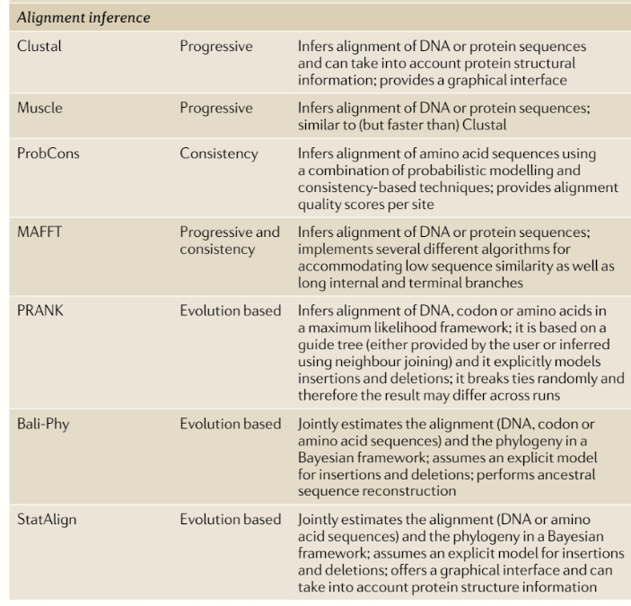
Why is aligment necessary?
There are three main considerations in choosing a program:
Biological accuracy
Execution time
Memory usage.
Kapli, Paschalia & Yang, Ziheng & Telford, Maximilian. (2020). Phylogenetic tree building in the genomic age.
Nature Reviews Genetics. 21. 1-17. 10.1038/s41576-020-0233-0.

Slide 9
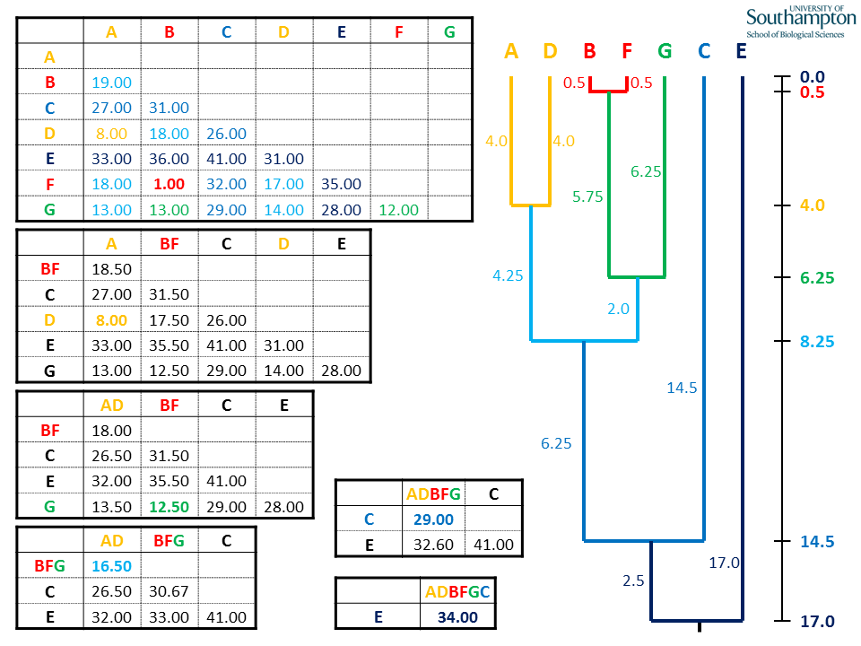
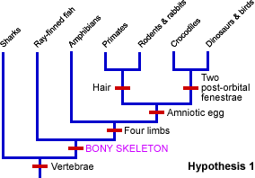
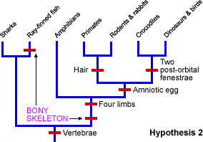
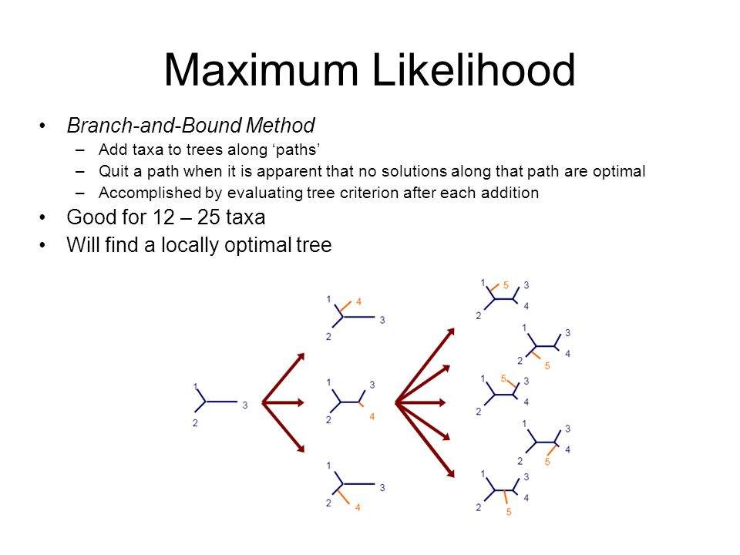
How to estimate a tree?
Maximum Parsimony
Distance method: Neighbour Joining (NJ), UPGMA.
Likelihood methods: Maximum likelihood and Bayesian likelihood
UPGMA
Maximum Parsimony
Maximum likelihood
Notes:
Lý do chọn Max-

Slide 10
How to estimate a tree?
 | Maximum parsimony | Distance method | Likelihood method
Advantages | - Simple and intuitive method. - Computationally efficient for small trees. | - Constructs a phylogenetic tree based on similarity - Allows for consideration of the rate of evolution | - Reliable and accurate results - Provides statistical support values (e.g., likelihood ratio tests, bootstrap values) for inferred branches.
Disadvantages | - Does not consider the rate of evolution - May not always be accurate. | - Depends on the chosen evolutionary model - Does not guarantee finding the optimal phylogenetic tree | - Computationally intensive and time-consuming, especially for large datasets. - May be sensitive to the assumptions made in the model and the quality of the input data.
Notes:
Lý do chọn Max-

Slide 11





What’s required to perform phylogenetic analysis?
- Sequence data: Obtain a set of Vietnamese SARS-CoV-2 genetic sequences from the GISAID database
- Bioinformatics toolkit: Augur (developed by Nextstrain)
A multiple sequence alignment program: Mafft
An alignment (made by using the two previously mentioned items)
Phylogenetic tree estimation software: iQ-TREE2
Phylogenetic tree visualization software: Auspice (developed by Nextstrain)

Slide 12
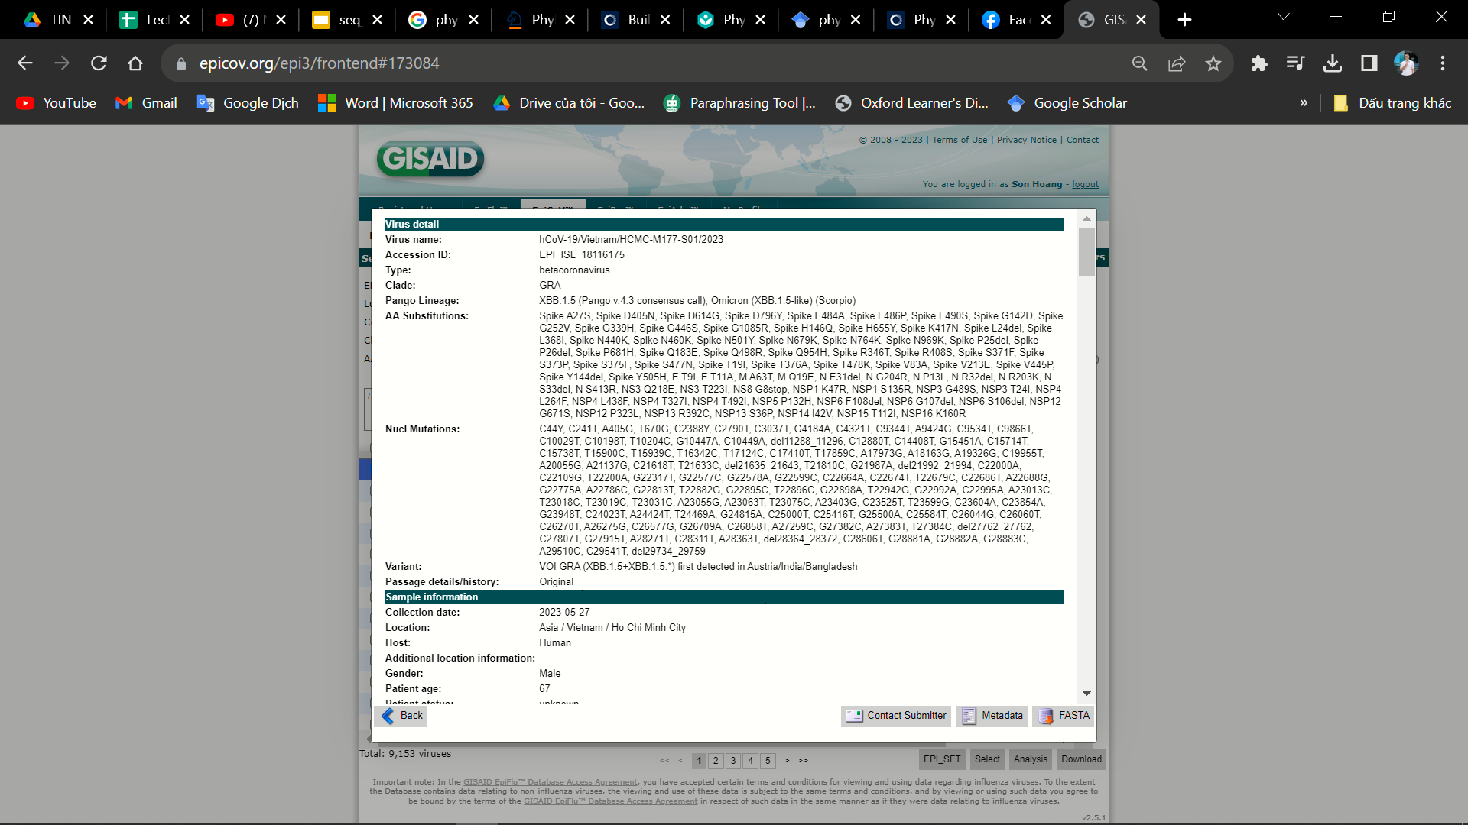
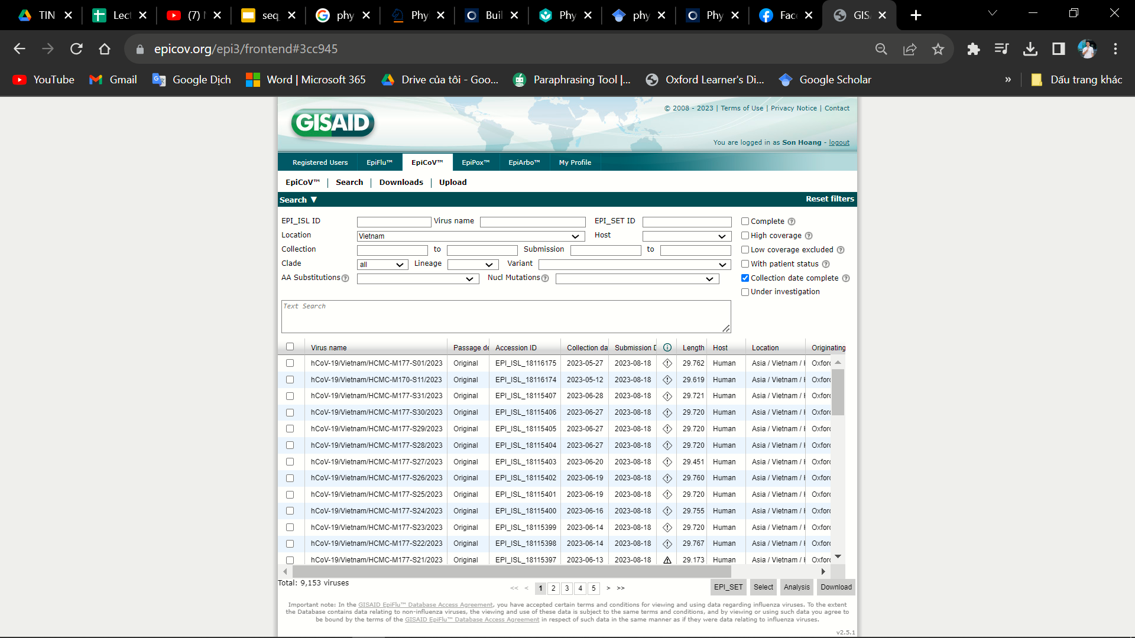
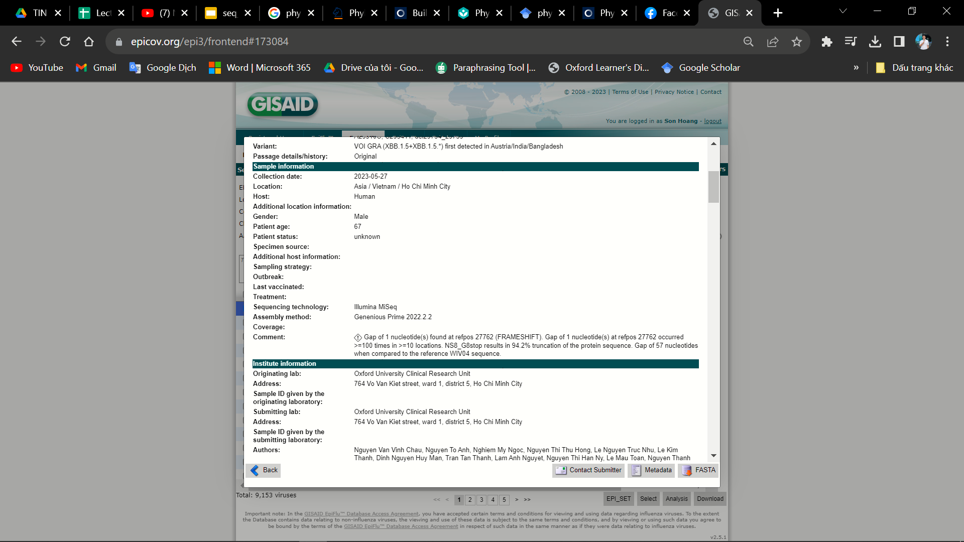
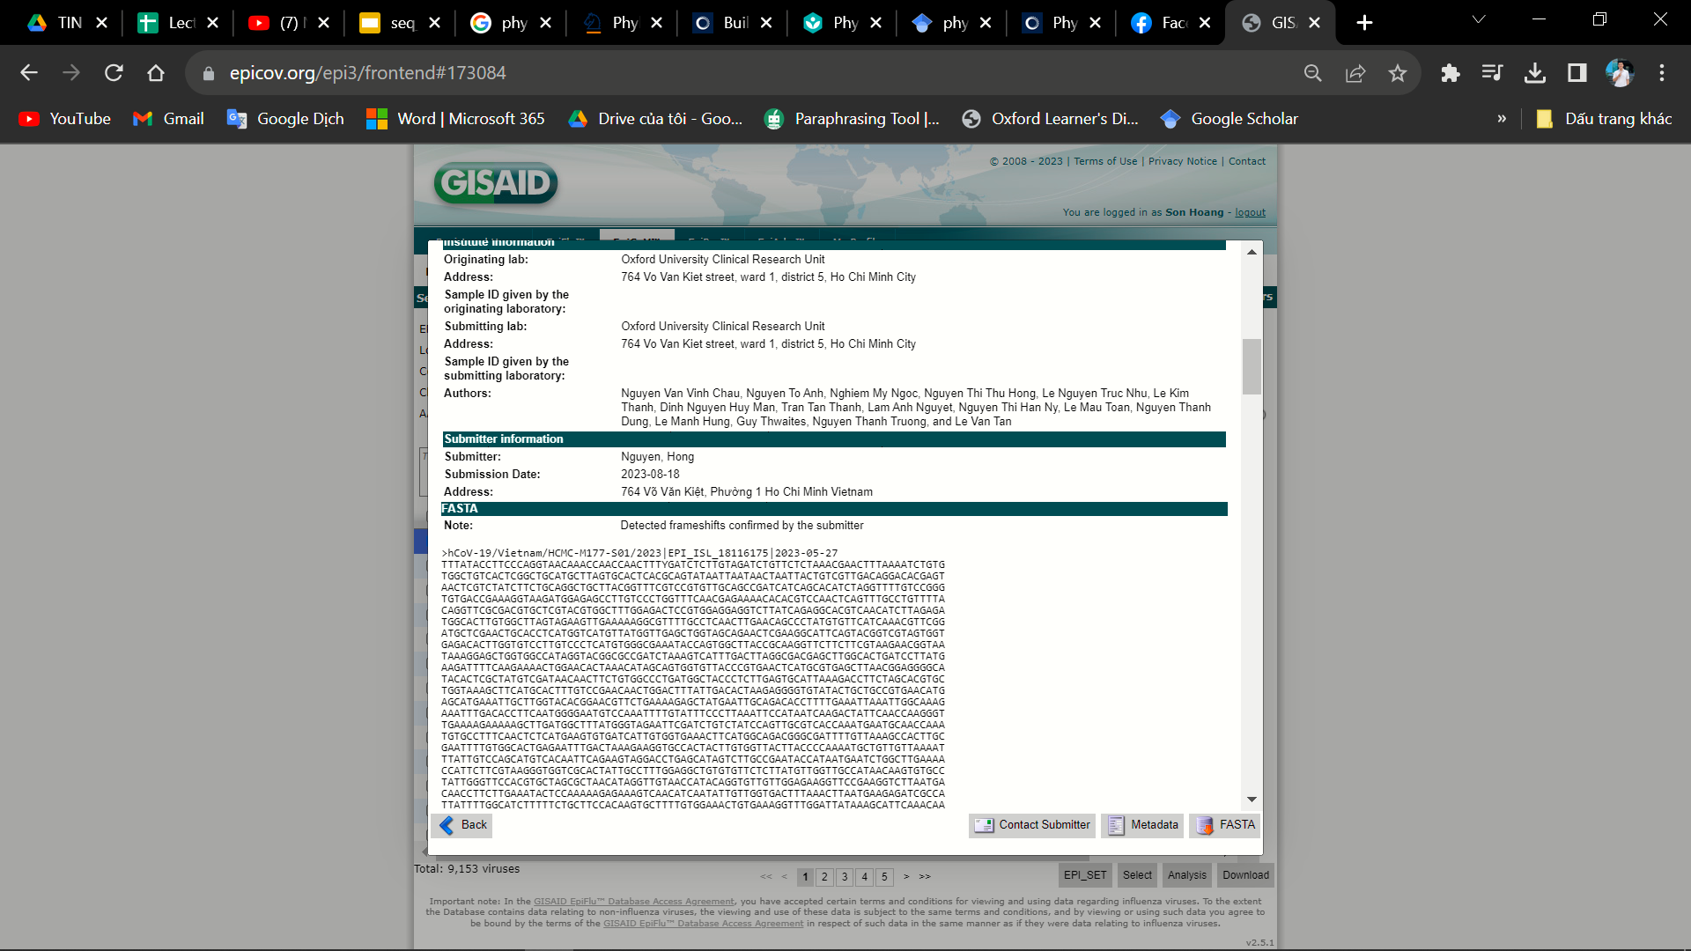
GIASIAD Database
We downloaded the raw data from gisaid.org on August 10, 2023.
It contained over 4,500 genome raw sequences including high and low coverage.

Slide 13

Official GISIAD Reference Sequence
hCoV-19/Wuhan/WIV04/2019 (WIV04) is the official reference sequence employed by GISAID (EPI_ISL_402124).
WIV04 was chosen because of its high-quality genome sequence and because it represented the consensus of a handful of early submissions for the betacoronavirus responsible for COVID-19.
(Pilailuk et al 2020)
Notes:
Giải thích việc sử dụng ref seq và các chủng

Slide 14
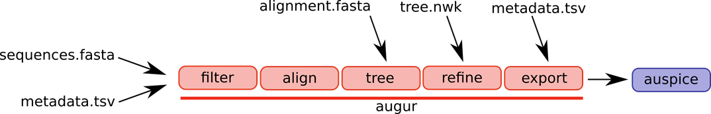
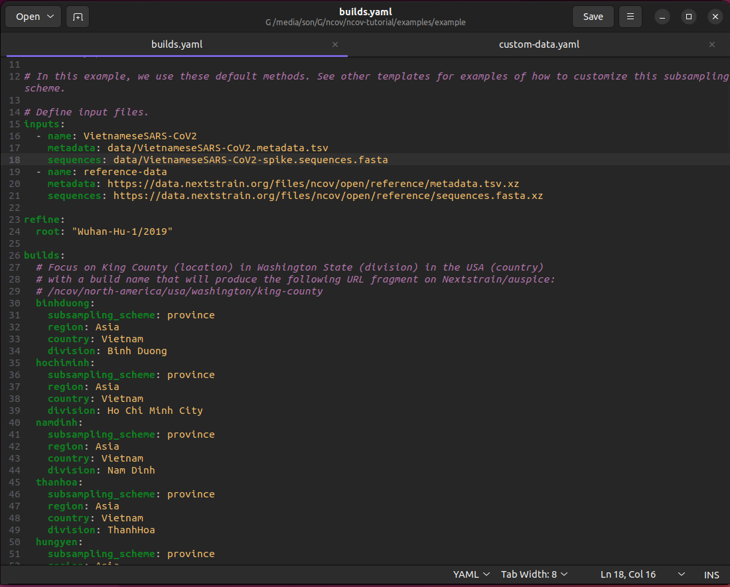
SARS-CoV-2 Workflow
pipeline preparation: build.yaml
https://github.com/nextstrain/ncov.git

Slide 15
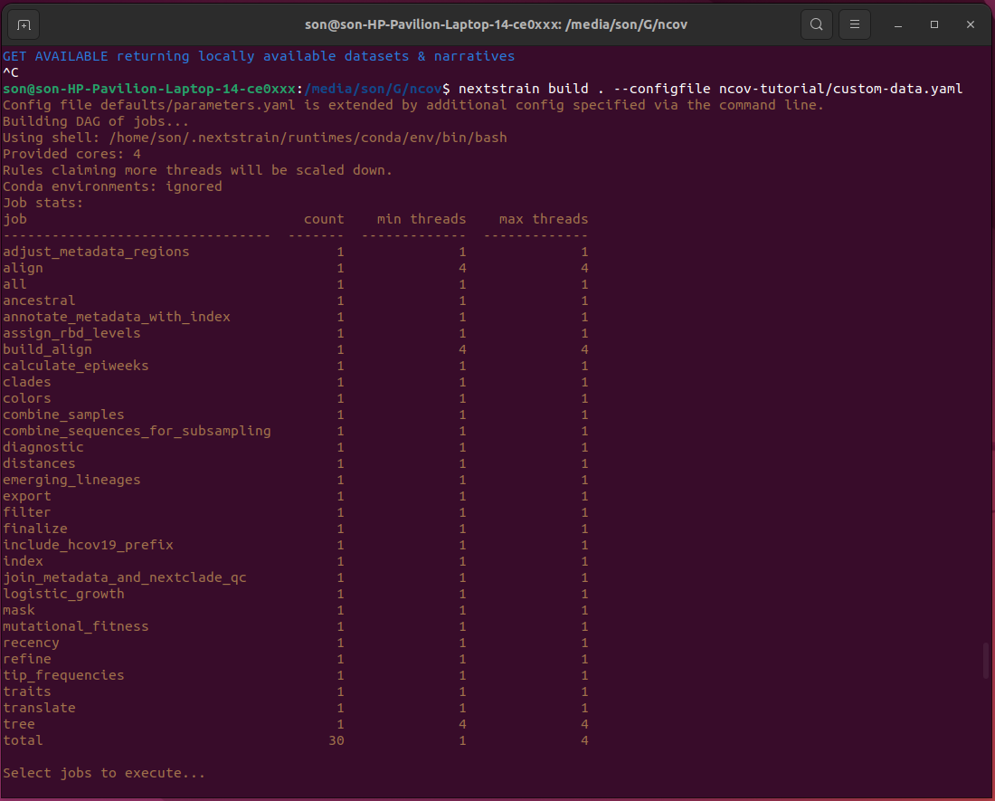
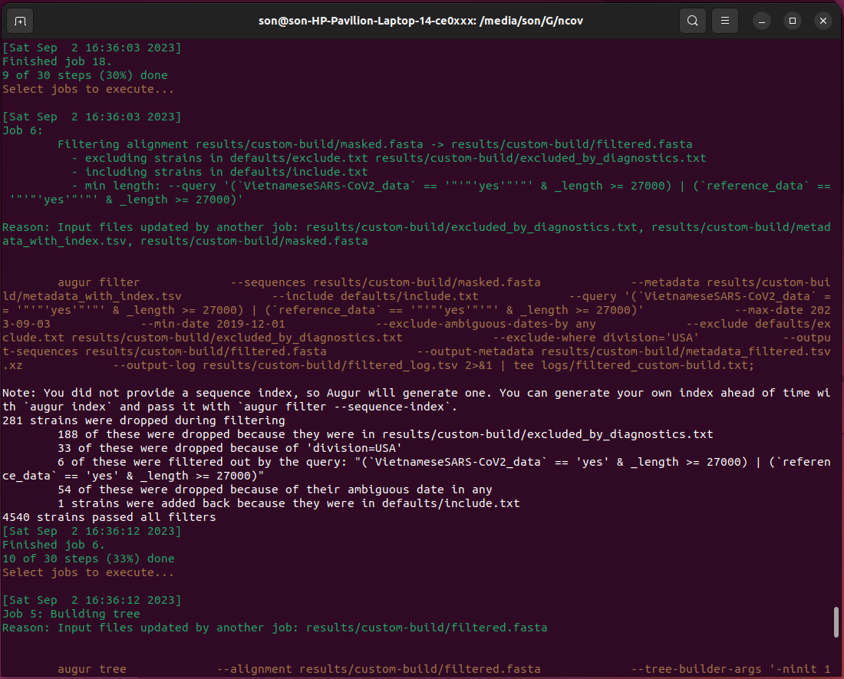
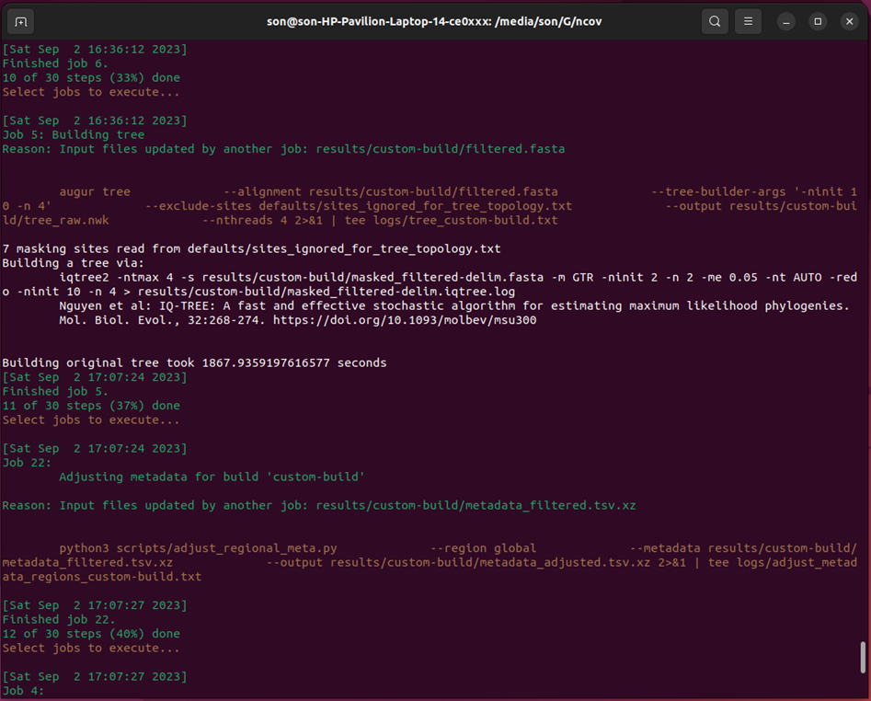
1. Set up pipeline
2. Filter data
3. Multiple sequence alignment (MSA): MAFFT
4. Initial Phylogenetic Tree: IQTREE2

Slide 16
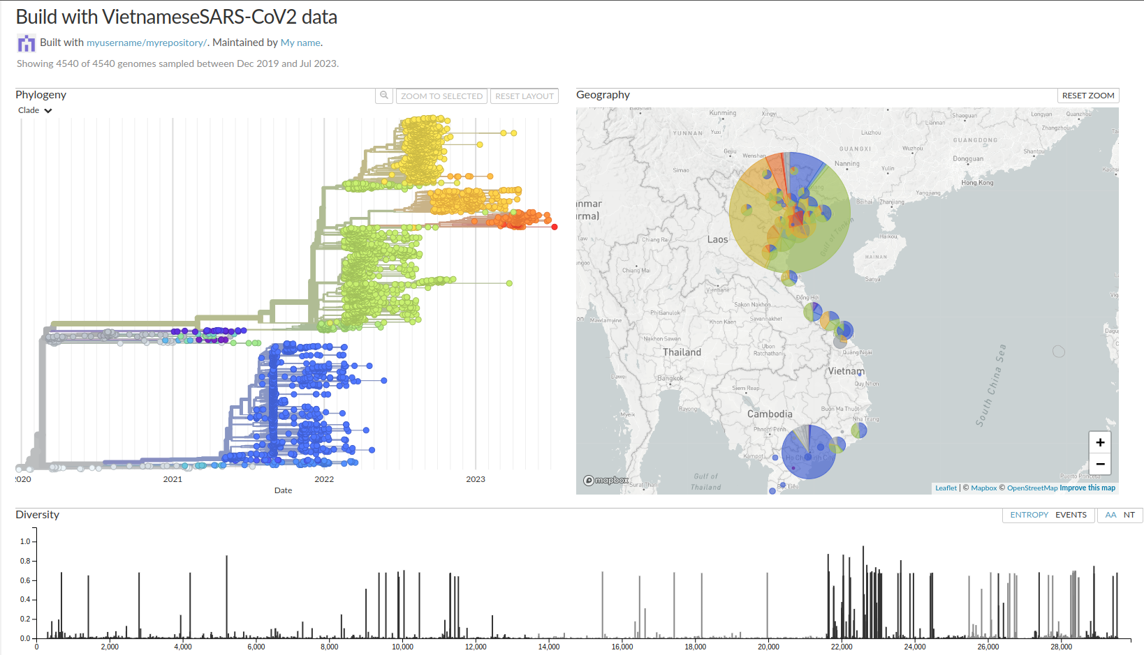
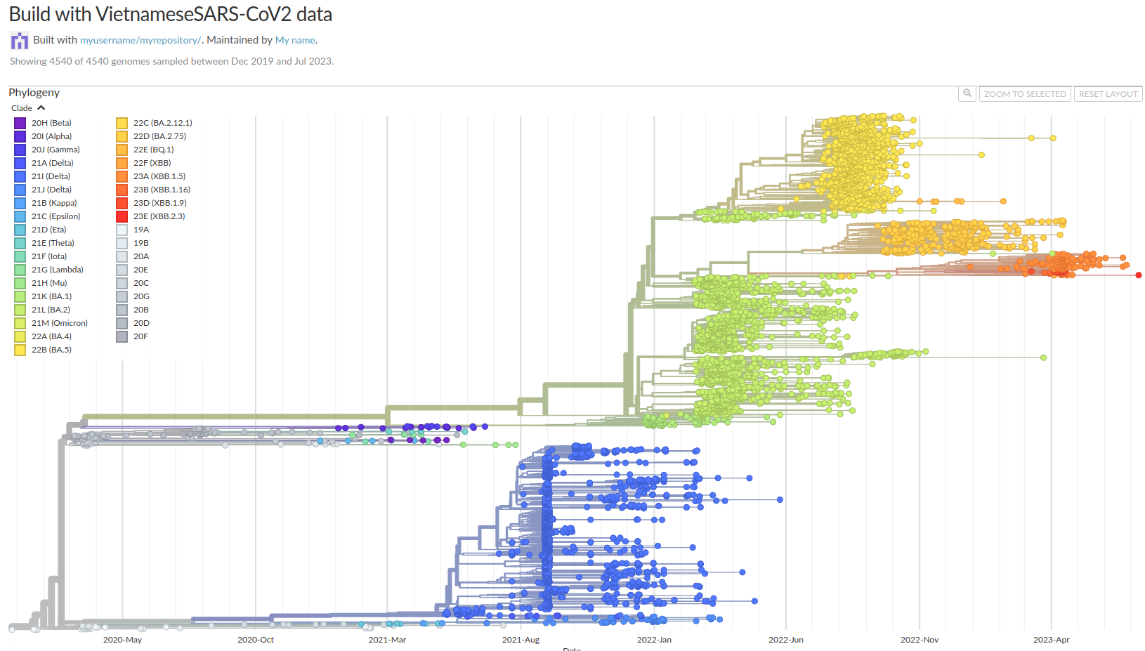
Visualization

Slide 17
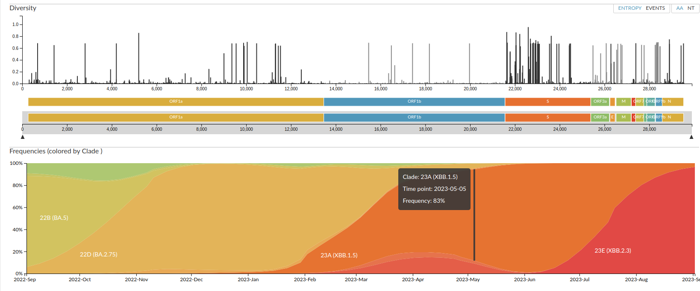
Visualization

Slide 18
Phylogenetic analysis of Vietnamese SARS-COV-2 genomes

Slide 19
Background and Aim
Characterization of severe acute respiratory syndrome coronavirus 2 (SARS-CoV-2) based on analyzing the evolution and mutations of viruses is crucial for tracking viral infections, potential mutants, and other pathogens.
The purpose was to study the complete sequences of SARS-CoV-2 to reveal genetic distance and mutation rate among different provinces of Vietnam.

Slide 20
Methods
Sample source
Full-length genomes (>29,000 base pairs) were obtained from Vietnamese provinces.
Data collected from GISAID database.
Timeframe: March 8, 2020, to April 28, 2021.
Sample size
A total of 4,571 samples from 24 Vietnamese provinces and 136 reference sequences (including WIV04).
Phylogenetic analysis
Nextstrain software utilized for analysis.
Sequence alignment: MAFFT.
Phylogenetic tree construction: IQ-TREE2 v2.2.0.3 (maximum-likelihood method).
Visualization software: Auspice

Slide 21
Result

Slide 22
Visualization

